Slide 1
Tasks and Alerts
Emanuele Della Valle
Prof. @ Politecnico di Milano
Founder & Partner @ Quantia Consulting
Marco Balduini
Founder & CEO @ Quantia Consulting
Riccardo Tommasini
Prof. @ University of Tartu

Slide 2
Motivation

Slide 3
Data-driven decision
Descriptive
What happen?
historical
analysis
Diagnostic
Why did it happen?
Predictive
What will happen?
Data
Decision
Action
Decision Support
reactive decisions
Prescriptive
What should I do?
Decision Automation
[src. Gartner]
Machine-centered
Human-Centered

Slide 4
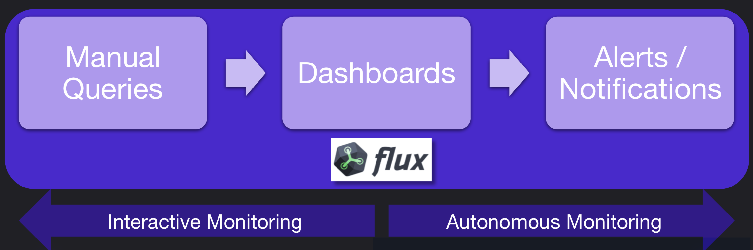
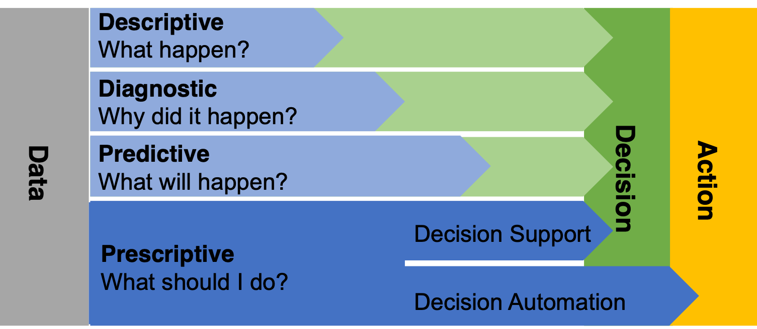
Interactive vs. Autonomous Monitoring

Slide 5

Recall
window
Data Sources
Registered Continuous Query
streams of answer
input streams
E. Della Valle

Slide 6
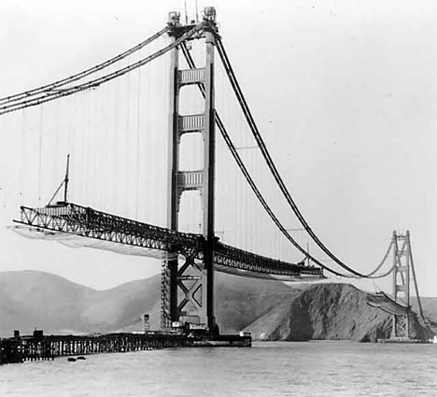
Interactive monitoring

Slide 7

Interactive monitoring vs. Continuous autonomous monitoring

Slide 8
Alerts

Slide 9

Anomalous Mozzarella Melting Temperature

Slide 10
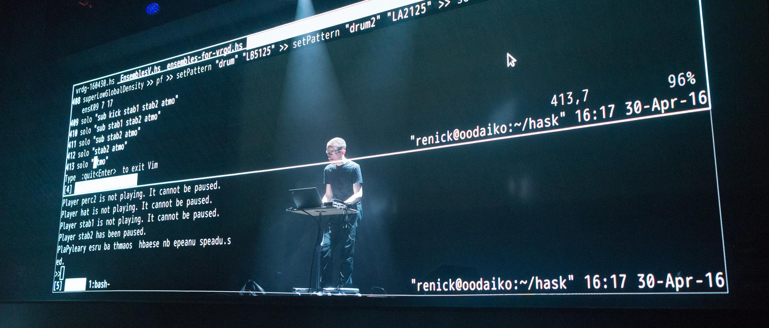
Let’s do some live coding

Slide 11
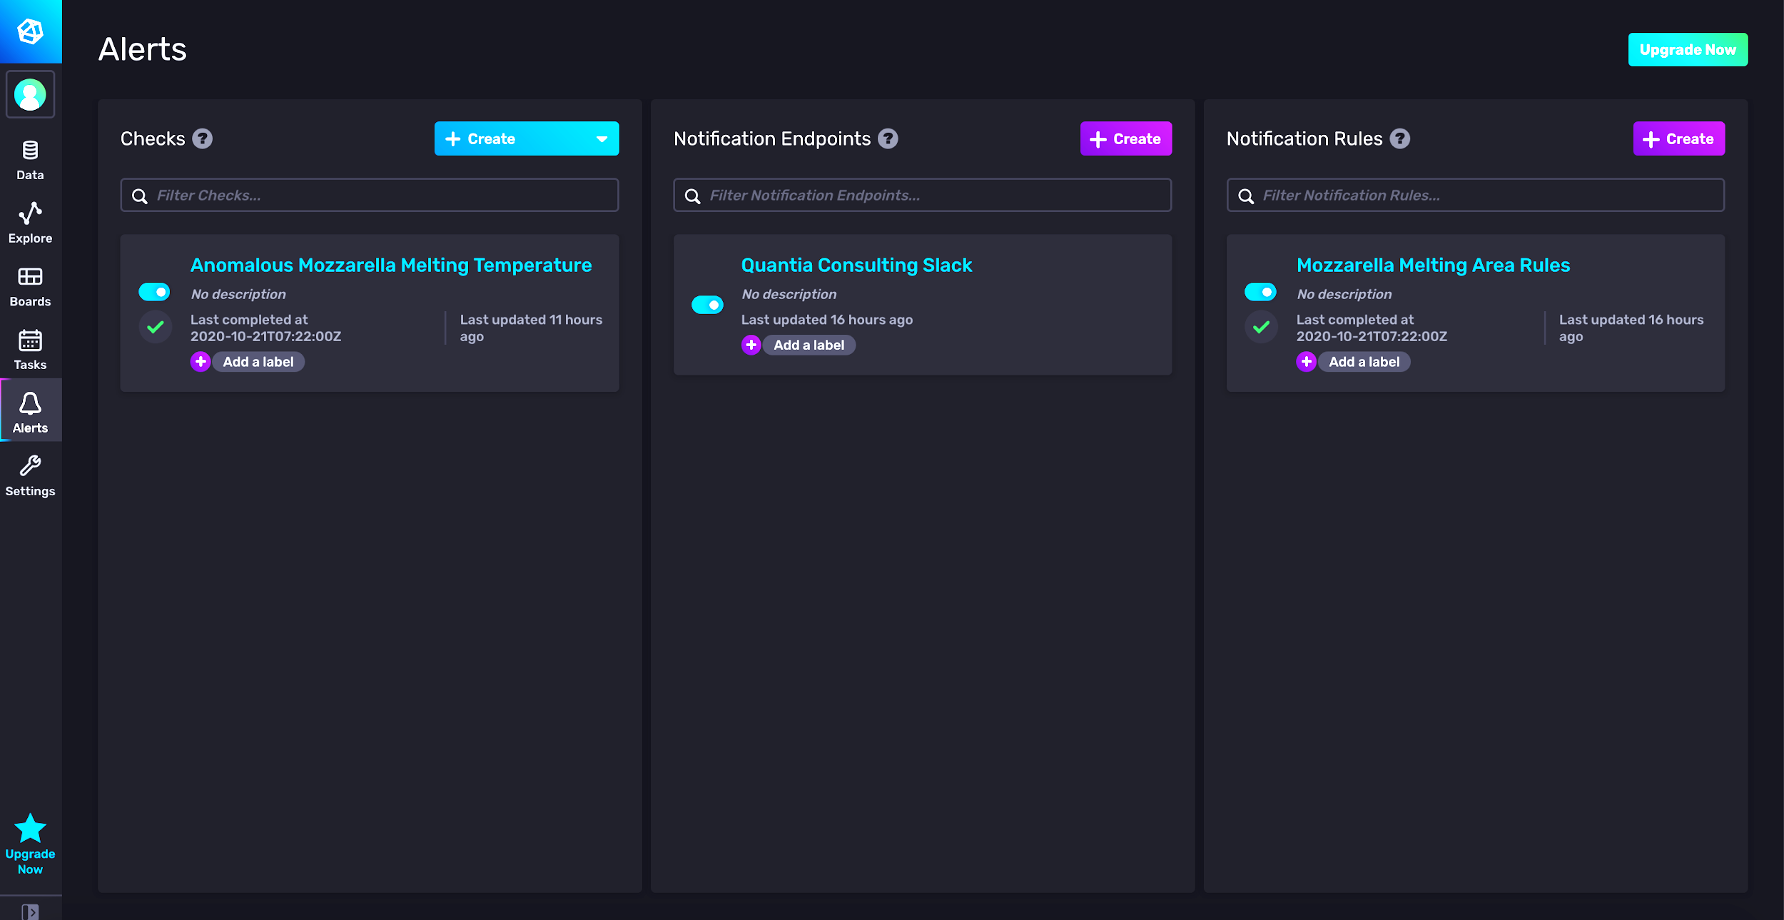
Alerts
Types of Alerts
Threshold
Deadman
Alerts are defined as
a base query
threshold criteria
condition mapping
notifications

Slide 12
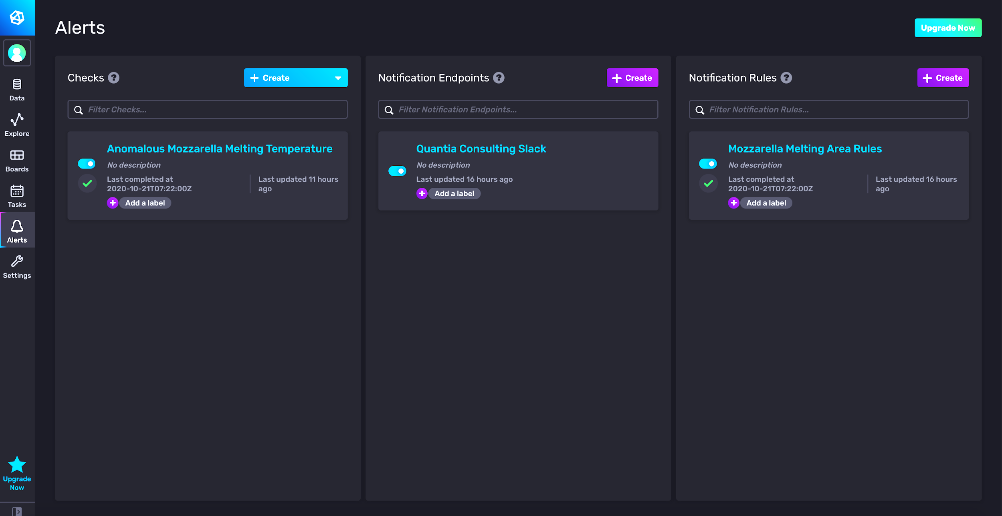
Alert-UI

Slide 13
Alert-UI - Checks

Slide 14
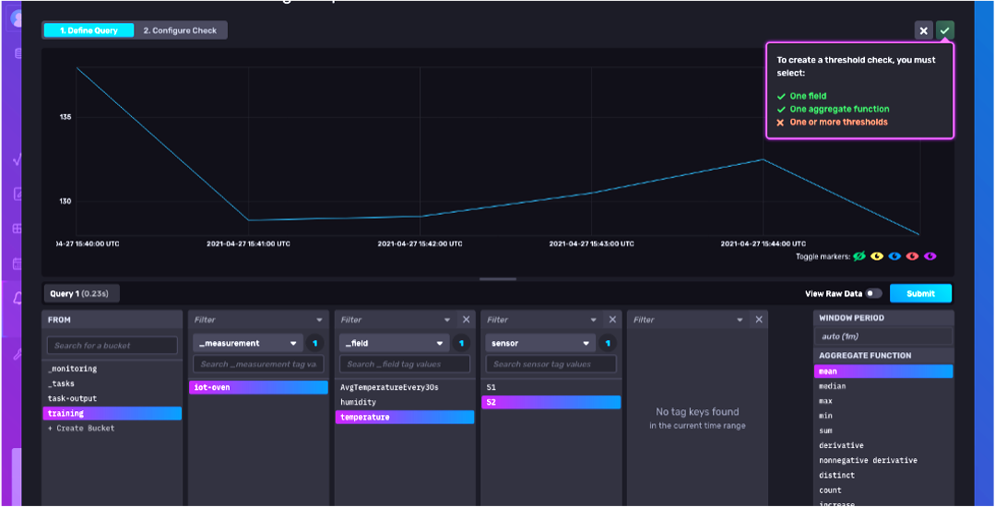
Alerts UI – check view – query pane

Slide 15
Alerts UI – check view – query pane
base query

Slide 16
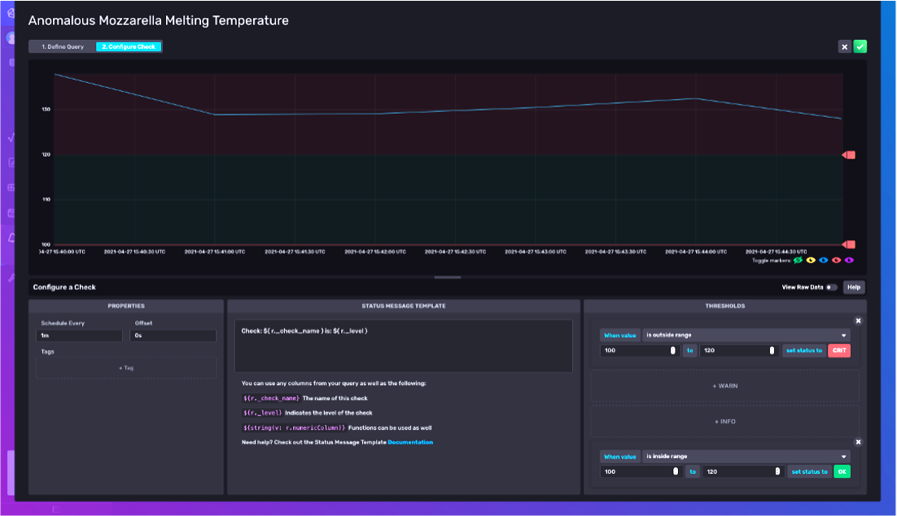
Alerts UI – check view – check pane

Slide 17
Alerts UI – check view – check pane
threshold criteria
condition mapping

Slide 18
Notifications
Possibility to define
Notification endpoints on a Slack channel

Slide 19
Notifications
Possibility to define
Notification endpoints on a Slack channel

Slide 20
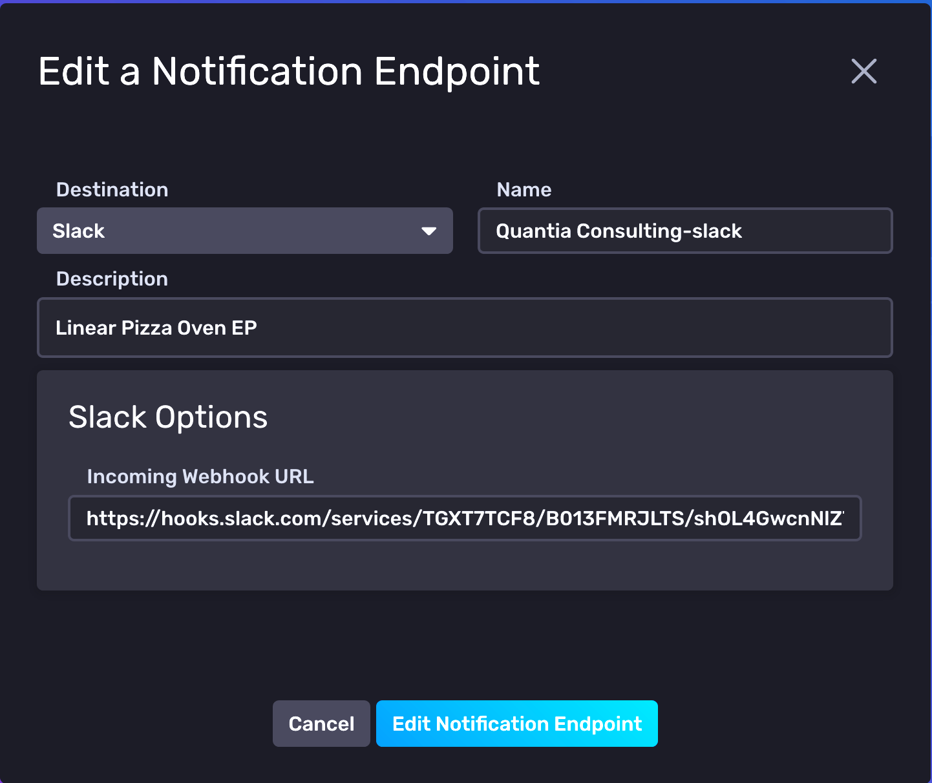

Notifications
Possibility to define
Notification endpoints on a Slack channel
Notification rules
When
What

Slide 21
Notifications
Possibility to define
Notification rules
When
What

Slide 22
Notifications
Possibility to define
Notification rules
When
What

Slide 23
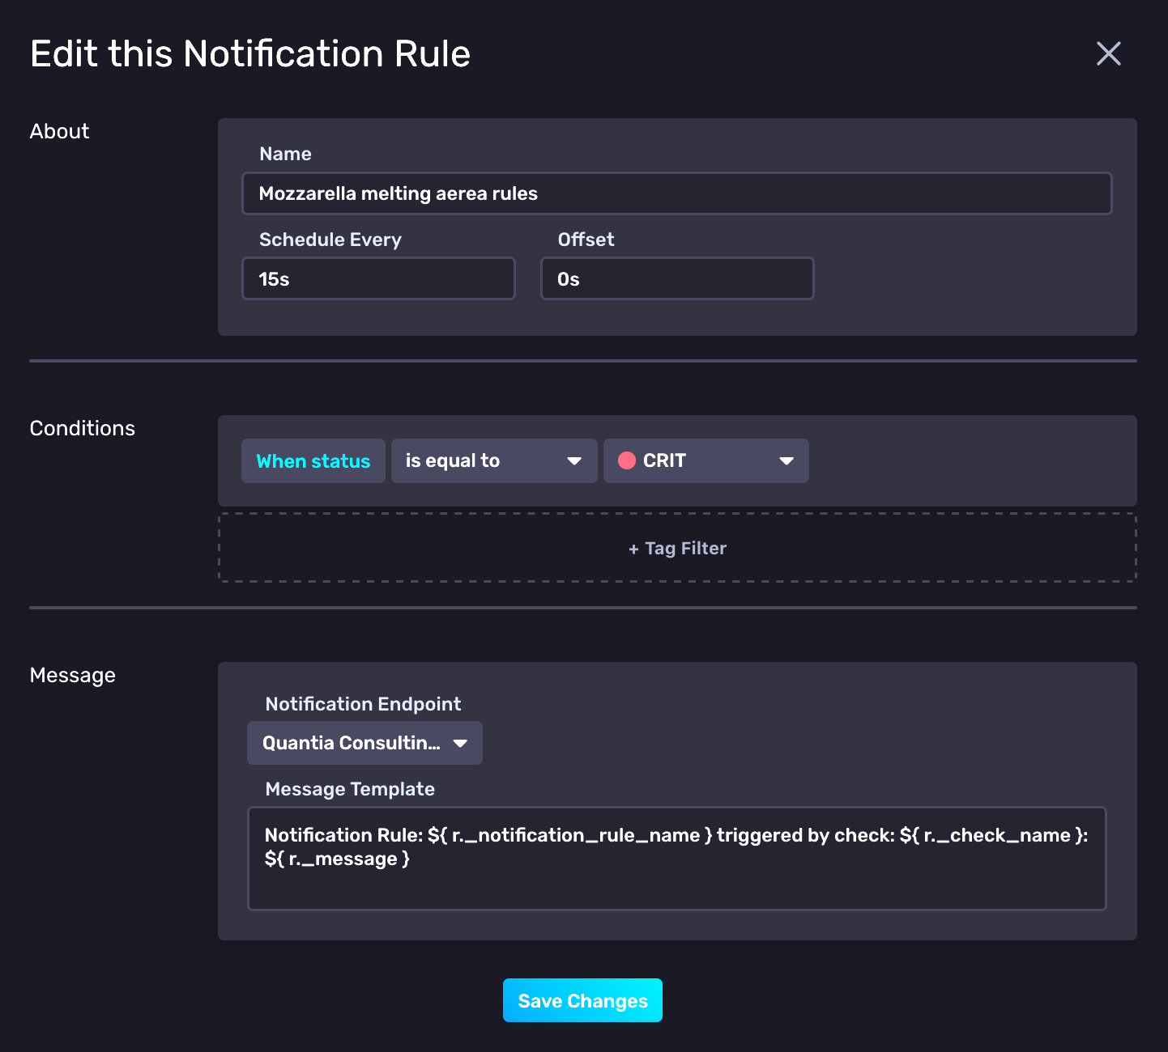
Notifications
Possibility to define
Notification rules
When
What

Slide 24
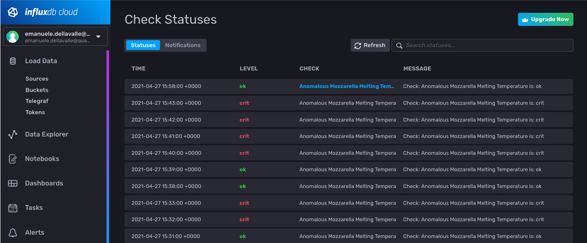
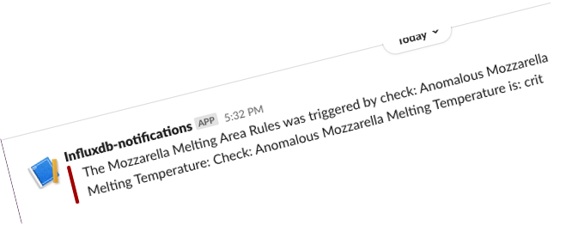
Alters history and notification on Slack

Slide 25
Tasks

Slide 26

The power of Flux for continuous processing and analysis

Slide 27
Tasks are Written in the Flux Language
No need to learn a separate language to write Tasks
No need to use separate tools for debugging Tasks
Tasks define all options within the script for portability
Options include
Name
Run Interval: every in CRON syntax
Tasks are self contained and can be imported / exported

Slide 28
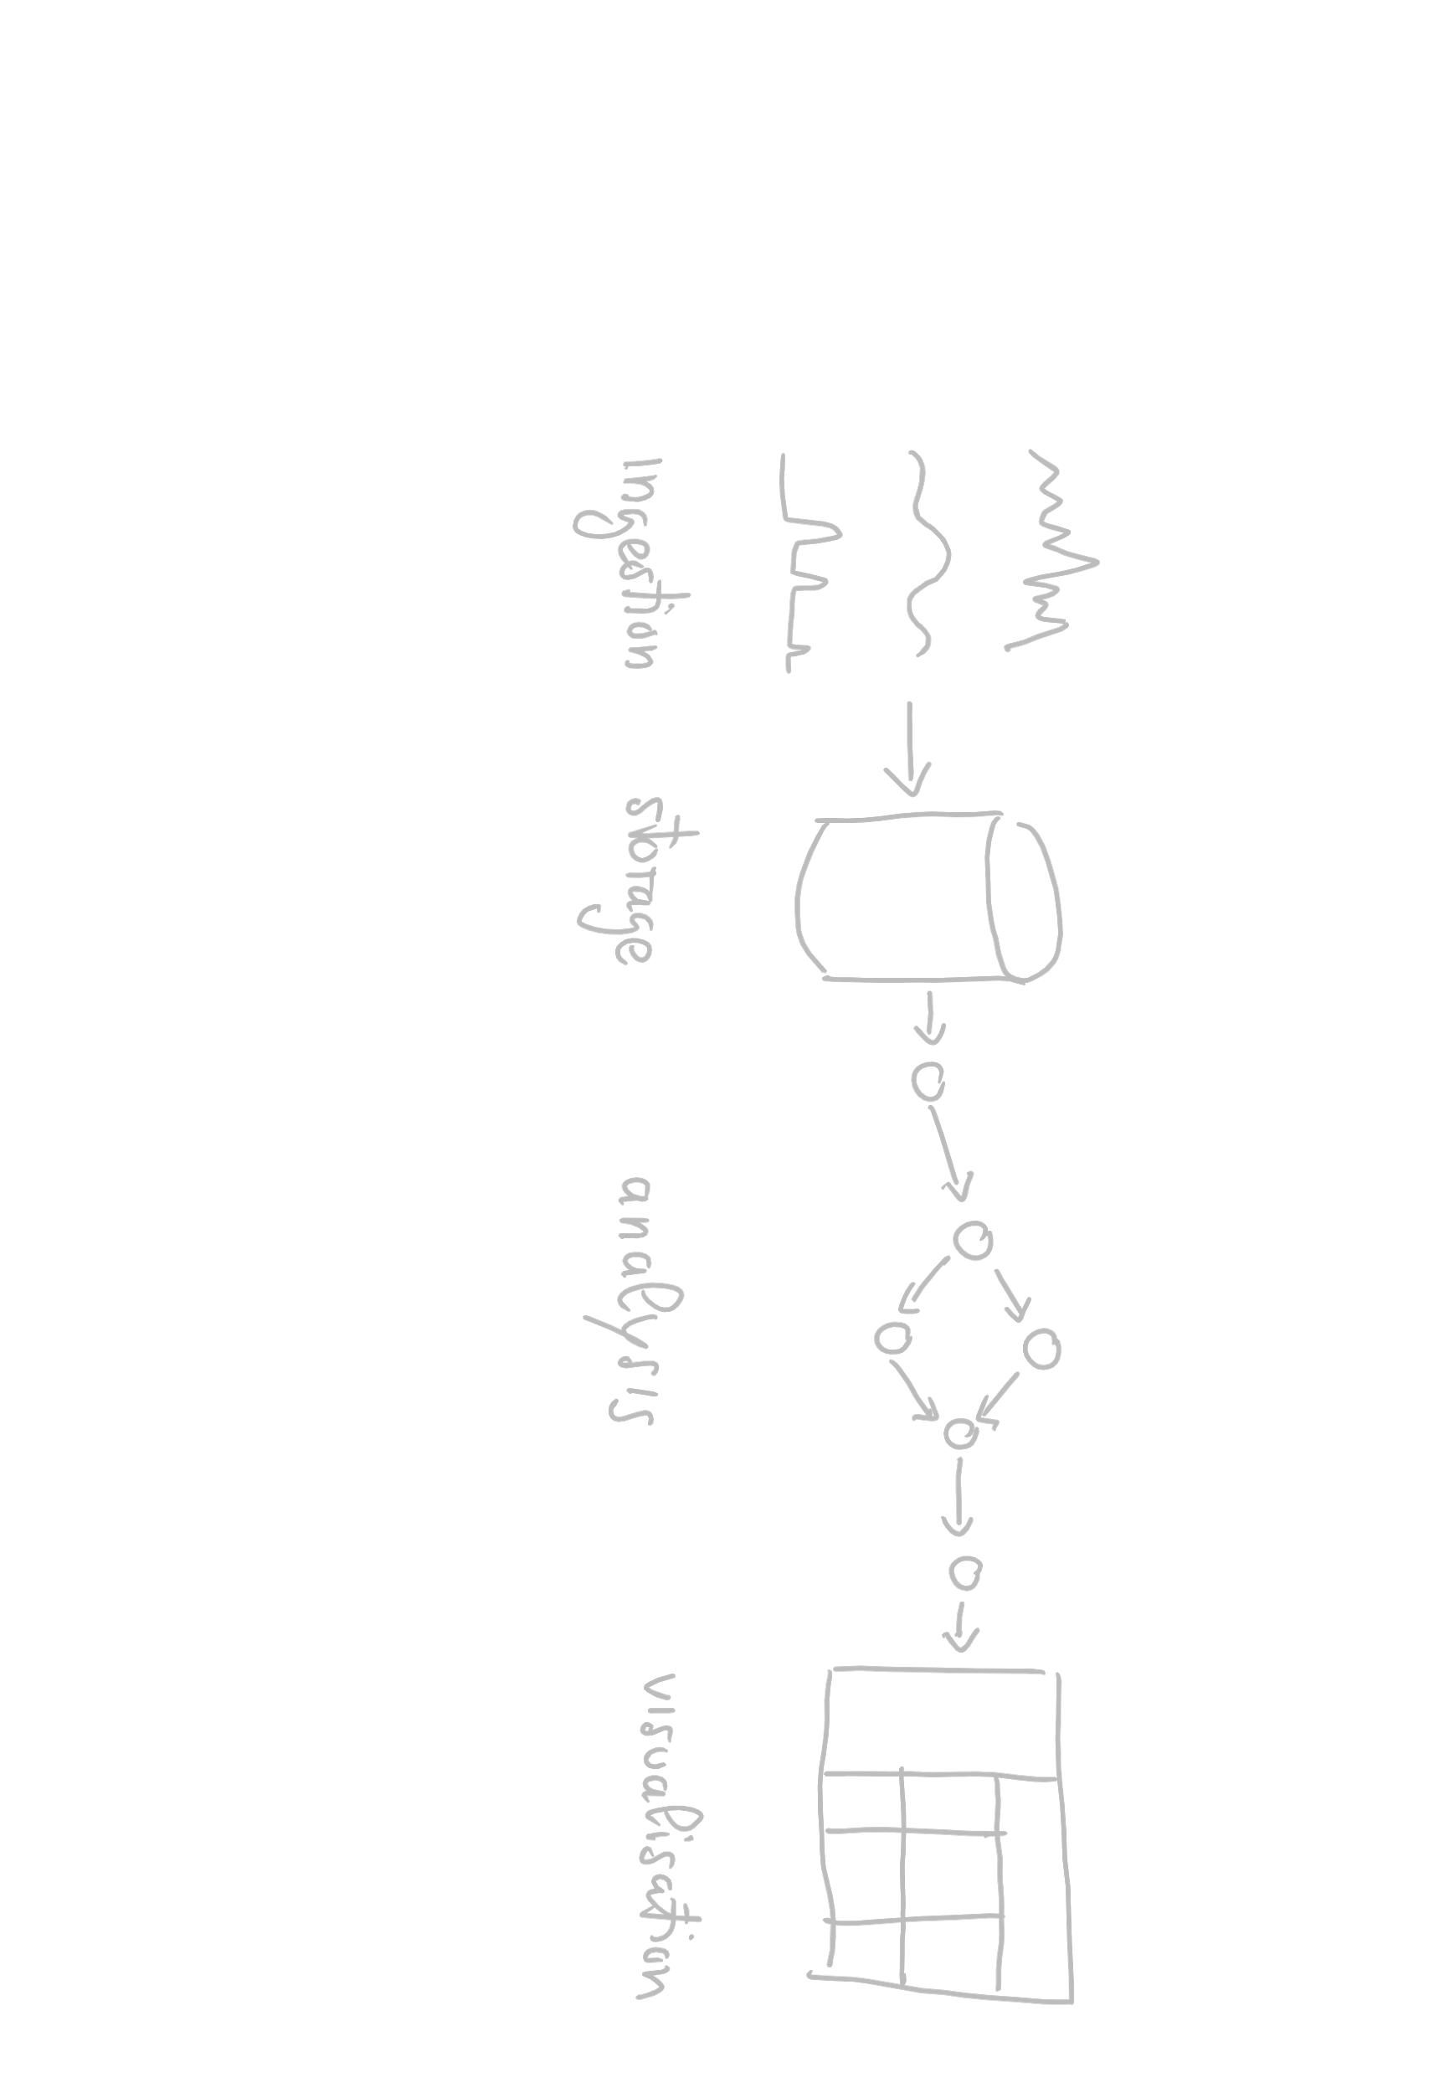
Recall the Data Lifecycle

Slide 29
Tasks continuously write back to the storage the results of the analysis

Slide 30
Let’s do some live coding

Slide 31
Here we go
from(bucket: "training")
|> range(start: -30s)
|> filter(fn: (r) => (r._measurement == "iot-oven"))
|> filter(fn: (r) => (r._field == "temperature"))
|> filter(fn: (r) => (r.sensor == "S1"))
|> mean()

Slide 32
Recall
range(start: -30s)
Data Sources
mean()
input streams
streams of answer
E. Della Valle

Slide 33
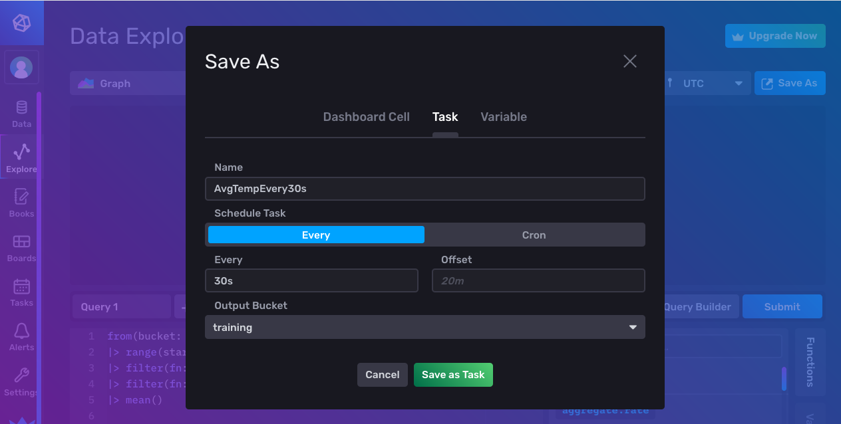
Let’s save it as a task …

Slide 34
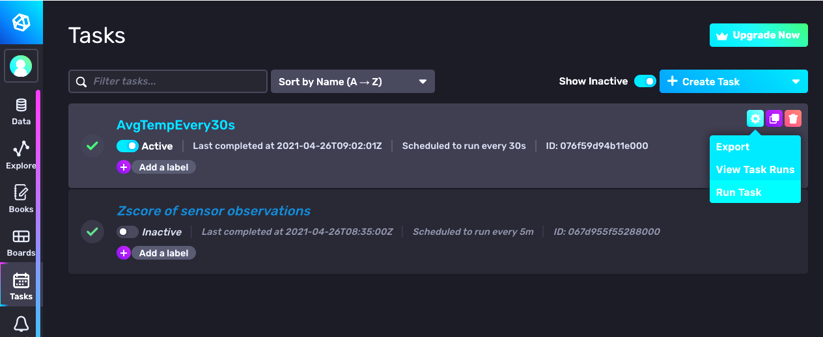
Here it is in the Task pane … let’s run it

Slide 35
It gives an error, why?
:-/

Slide 36
It’s not the missing to() … the UI added it for us
Syntax
to(bucket: <<name>>, org:<<organization>>)
Example
from(bucket:"foo")
|> ...
|> to(bucket: ”bar", org:”some@quantiaconsulting.com")

Slide 37
What are we missing?
The output data format does not comply with InfluxDB data model:
- _time is missing
Moreover, semantically, the name of the field is still the one of the original observation:
- We may want to rename it in AvgTemperatureEvery30s

Slide 38
Here we go :-)
from(bucket: "training")
|> range(start: -30s)
|> filter(fn: (r) => (r._measurement == "iot-oven"))
|> filter(fn: (r) => (r._field == "temperature"))
|> mean()
|> map(fn: (r) => ({r with _time: r._stop}))
|> map(fn: (r) => ({r with _field: "AvgTemperatureEvery30s"}))
|> to(bucket: "training", org: "…@quantiaconsulting.com")

Slide 39
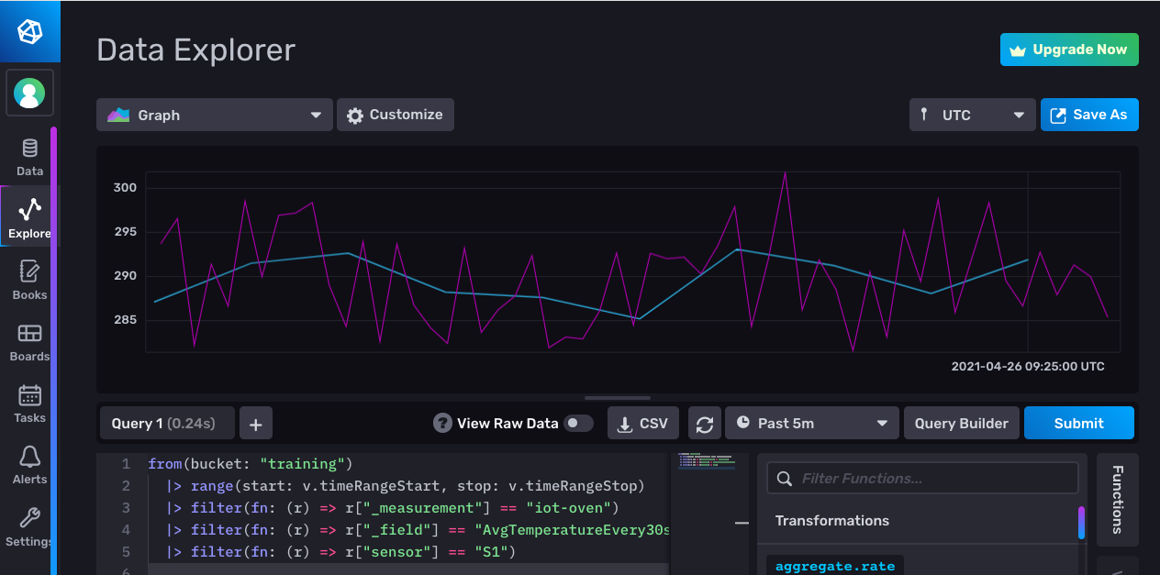
Let’s visualize the results

Slide 40
Tasks and Alerts
Emanuele Della Valle
Prof. @ Politecnico di Milano
Founder & Partner @ Quantia Consulting
Marco Balduini
Founder & CEO @ Quantia Consulting
Riccardo Tommasini
Prof. @ University of Tartu

